Slide 1
TERRANOVA KAZAKHSTAN
Supplier of Instrumentation and Engineering Solutions

Slide 3
OUR VISION
Combining Italian manufacturing traditions and quality with local expertise, we create reliable measurement solutions for Kazakhstan’s industry.
Our goal – Localization, Development, Partnership
Concision in style,
precision in thought,
decision in life.
Victor Hugo

Slide 4
Terranova® is a group gathering the oldest and most historical Italian Brands of Process Instrumentation.
Spriano® began its activity with the manufacture of the first pressure, temperature gauges, and pneumatic devices for Oil & Gas and rubber Industry.
Valcom® started with the designing and manufacturing of measurement and control instruments with specific expertise in the Pulp & Paper Industry.
Mec-Rela® engineered and manufactured a complete line of Control Valves providing effective solutions for Industrial applications in extremely harsh conditions

Slide 5
8,5
150
135
More than 8,5% of yearly revenue reinvested in R&D
Globally over 150 years of field experience
135 Countries
proudly served Worldwide

Slide 6
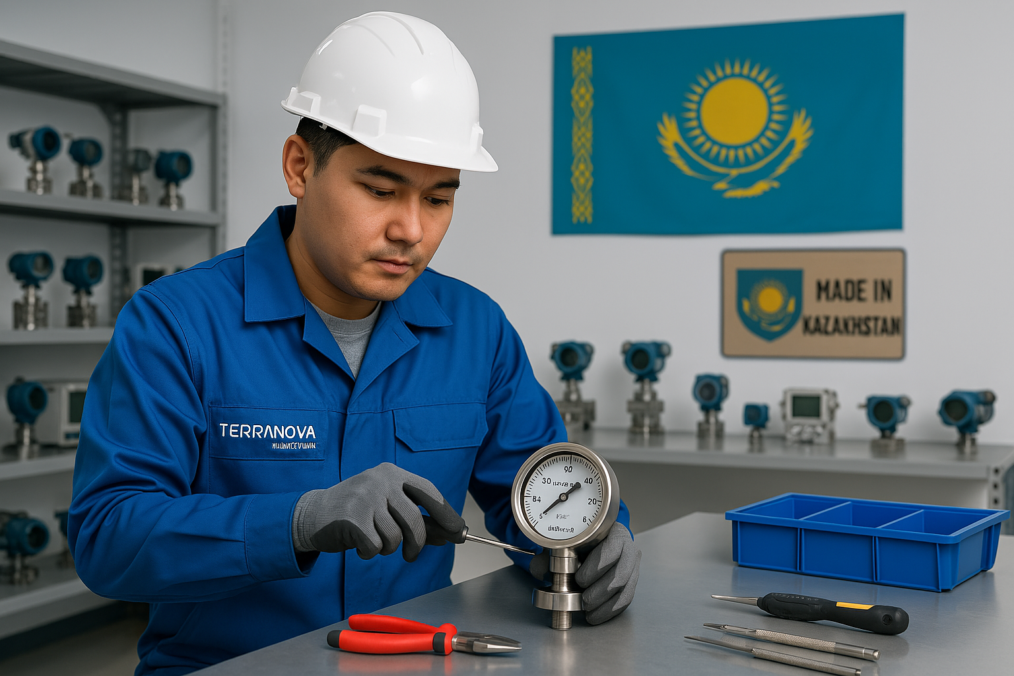
WHO WE ARE
TERRANOVA Kazakhstan is a 100% Kazakhstani company.
It is the official and exclusive representative of TERRANOVA Srl (Italy) in the Republic of Kazakhstan and CIS countries.
WE PROVIDE
Instrumentation Supply
Engineering services
Tranings
Warranty and post-warranty support
Technical assistance and support
Local on-site service support
OUR COMMITMENT
Launch of local instrument production planned by Q2 of 2026
Certification of products with ST-KZ and KZ Metrology approval
Increase of Kazakhstani content share
Creation of new jobs and development of engineering expertise in the country

Slide 7
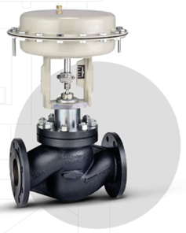
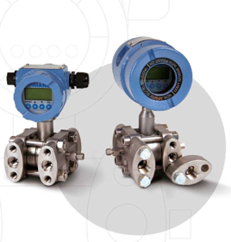
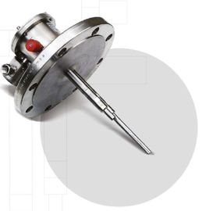
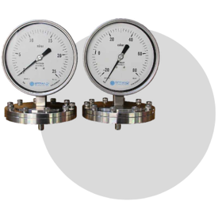
PRODUCTS
Terranova® designs, develop and manufactures process instrumentation.
Our first-in-class products are used for many applications globally, thanks to our attitude in developing tailor-made solutions.
Pressure, level, temperature, and flow transmitters
Gauges for pressure, level, and temperature
Switches
Control Valves

Slide 8
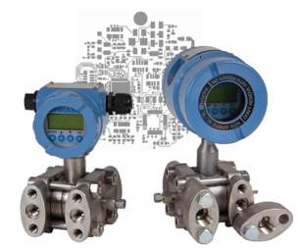
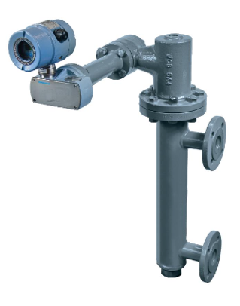
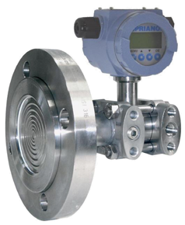
INSTRUMENTS FOR OIL & GAS INDUSTRIAL APPLICATION
Built-in microprocessor for signal processing, HART® 7 communication protocol, and standard 4÷20 mA analog output
High pressure ratings up to 1000 bar
Dual 16-bit input for differential signals from analog sensors (Piezoresistive, Pt100, photodiodes, etc.)
High accuracy up to 0.075 % FS
ATEX Exia and Exd certified
SIL 2 level certified
Fully developed in Terranova®’s in-house Research and Development Center
Flexibility for custom design
Included in the Metrological Register of the Republic of Kazakhstan
Certified according to TR CU 012/020

Slide 9
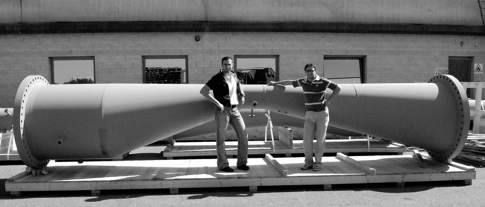
TERRANOVA Kazakhstan is an exclusive representative of TECNOMATIC, which is part of the TERRANOVA GROUP.
TECNOMATIC was founded in 1962 and is one of the oldest European manufacturers of flow and temperature measurement assemblies for the following sectors:
Oil and gas industry (Onshore and Offshore)
Chemical and petrochemical industry
Energy and metallurgy
Fertilizers and ammonia

Slide 10
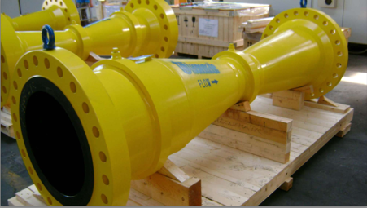
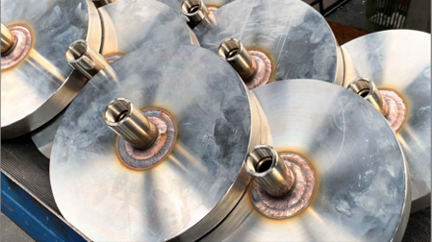
FLOW ELEMENTS:
Venturi Tubes and Cone Meters
Multiport Averaging Pitot Tubes (Mapflow)
Wedge Meters (ideal for slurry/dirty flow)
Flow Nozzles (ISA, ASME, Venturi type)
Flow Conditioners (Zanker, Tube Bundle, Gallagher, etc.)
Orifice Plates & Assemblies (Square edge, Quadrant, Segmental, etc.)
Meter Run Assemblies (high-accuracy for small diameters)
Single & Multistage Pressure Reduction
TEMPERATURE MEASUREMENT:
Thermocouples
RTDs — IEC 60751 standard
Thermowells
Skin-Type Thermocouples
Multipoint Thermocouple Assemblies

Slide 11
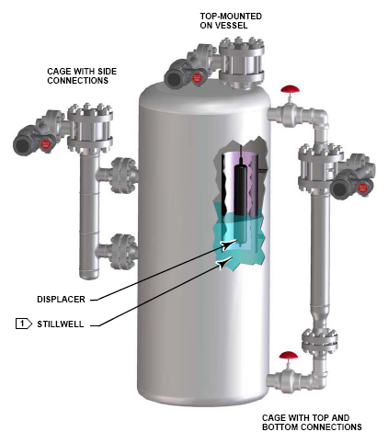
ENGINEERING
TERRANOVA Kazakhstan offers a wide range of engineering solutions in field instrumentation and automation. Our team are experienced Engineers with years of design and practical experience in international oil & gas projects.
We provide:
Selection and design
Design deliverables documentation
Supply, installation and commissioning
Support and training
TERRANOVA Kazakhstan successfully cooperates with leading international engineering companies and is ready to be a reliable partner in your projects.

Slide 12
OUR CLIENTS

Slide 13
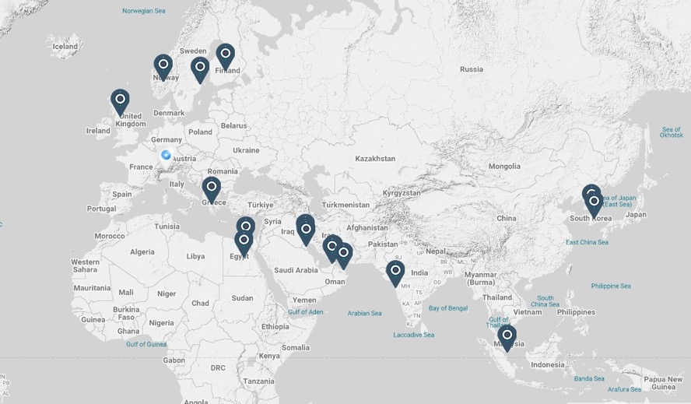
OUR CONTACTS
HeadQuarter:
Via Rosso Medardo 16, 20159 Milano, Italy
Tel: +39 0377 911066
www.terranova-instruments.com
info@terranova-instruments.com
TERRANOVA Kazakhstan:
Office:
68, Abay av., Almaty, 050000
Tel: +7 705 211 43 43 (BDM)
Service Center:
84/2, B. Zharbosynova st., Atyrau, 060000
www.terranova-instruments.kz
sales@terranova-instruments.kz

